Slide 1
Subscribe to DeepL Pro to edit this document.
Visit www.DeepL.com/pro for more information.

Slide 2
Track 01 - Blockchain for IoT
Antonio Tenorio Fornés and Rubén Fuentes Fernández GRASIA-UCM - Intelligent Infrastructure Design, Master IoT

Slide 3
Decentralization

Slide 4
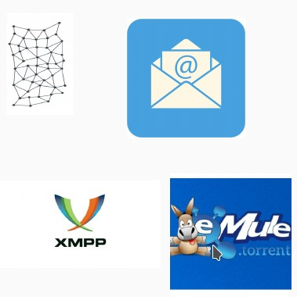
Before Blockchain
Advantages
Disadvantages

Slide 5
After Blockchain
Blockchain
Bitcoin
Anyone else?

Slide 6
History
From Bitcoin to Blockchain

Slide 7
What is Bitcoin?
First distributed digital currency
Proposal by Satoshi Nakamoto
10/31/2008 - Article published on the metzdowd.com cryptography mailing list
2009 - Launches Bitcoin software, which creates the network, and the first units of the currency.
Mid 2010 - End of his collaboration with the project.
Transfers control of the source code repository and the network alert key.
Notes:
https://www.criptonoticias.com/redes-protocolos/bitcoin-core-revela-claves-sistema-alerta-red-creado-nakamoto/
The Alert System, deployed throughout the Bitcoin network, was created by Satoshi Nakamoto to inform users about important topics on the network, says the Alert System Retirement document published on Bitcoin.org on November 1, 2016. The system had been used in the past to report relevant events, such as accidental forks of the blockchain, but several important vulnerabilities were noticed:

Slide 8
Who is Satoshi Nakamoto?

Slide 9
Who is Satoshi Nakamoto?
Nakamaoto Bitcoins remain unchanged since January 2009
As of May 2017, Nakamoto had approximately 1 million Bitcoins.
Approximate value of $15 billion USD in December 2017.
At the December 2017 peak Forbes estimated $19 "billion" USD, 44th richest person in the world.

Slide 10
Why Bitcoin?
No trust in third parties
Reduce costs
Privacy
Avoiding corruption
…

Slide 11
Bitcoin and Blockchain
Bitcoin is considered the birth of Blockchain technology.
Later other Blockchains became popular
Ethereum ( https://www.ethereum.org/ )
Various Hyperledger projects ( https://www.hyperledger.org/ )
Other Blockchain-like solutions.
Notes:
s

Slide 12
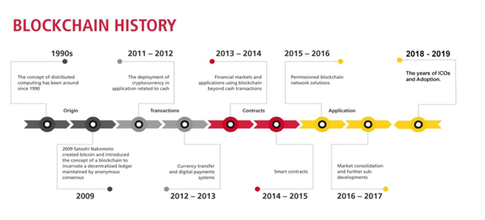
Bitcoin and Blockchain - History

Slide 13
Bitcoin and Blockchain - History

Slide 14
Blockchain

Slide 15
Why Blockchain?
Problem of double spending in decentralized systems
How to prevent A from paying B and C using the same currencies
Consensus on the status of records
Immutable
Verifiable
…

Slide 16
How?
Blockchain is a system:
That stores transactions
On immutable public accounting records (or ledgers)
Ledgers
Through decentralized peer-to-peer work
Peer to Peer, P2P
Whose security is based on encryption processes
And consensus mechanisms
Ex. Proof of Work (PoW)
Can optionally support smart contracts

Slide 17
Blockchain
The use of the blockchain structure together with the proof of work allows to make a decentralized and secure registry.
Creation of the first cryptocurrency, Bitcoin.
The Blockchain Demo website allows you to explore blockchain concepts in an interactive way.
See hash, block, blockchain, blockchain, distributed chains, transactions...
Notes:
The nonce is the hash of the previous block, the reference to it.

Slide 18
Identity
Each identity on the Blockchain is associated with an asymmetric key, consisting of:
Public key (public address)
Address to receive or send a transaction
Private Key (secret key)
Authorize (sign) transactions
Notes:
BLOCKCHAIN.pptx

Slide 19
Cryptographic hashes
What are they?
What are the requirements?
Notes:
BLOCKCHAIN.pptx

Slide 20
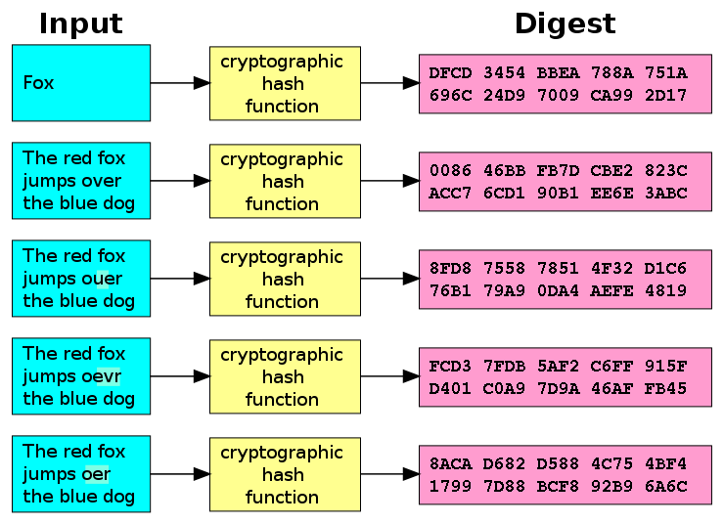
Hash functions
A hash function is a mathematical algorithm that maps a set of data of arbitrary size to a string of characters (or bits) of fixed size, and is a one-to-one function.
Some algorithms:
MD5, SHA1 (invalid)
SHA2 (SHA-256, SHA-512)
SHA3, BLAKE2

Slide 21
Cryptographic hashes
Given some data, a hash function generates a "fingerprint" with the following characteristics:
Determinism: The same data always generates the same hash.
Low cost: Calculating the hash of any data is computationally simple.
Pre-image resistance: It is computationally intractable to know the data from its hash.
Collision resistance: It is computationally intractable to find two pieces of data that generate the same hash.

Slide 22
Cryptographic signature verification
Notes:
BLOCKCHAIN.pptx

Slide 23
Encryption
Standard encryption practices
Some Blockchain allow the use of Bring Your Own Encryption (BYOE).
As good as the next SW and/or HW innovation
E.g. quantum computing
All blocks are encrypted

Slide 24
Transactions
Historical archive of decisions and actions taken.
Proof of history and provenance
Use cases
Land Registry | Replacement of deed research requirements. | Land registration in Sweden
Personal identification | Replacement of birth/death certificates, driver's licenses, social security cards. | Estonia
Transport | Shipping information, tracking, certificates of origin, international forms. | Maersk / IBM
Banking | Document storage, increased back office efficiency. | UBS, Sberbank of Russia
Food distribution | By providing location, lot, harvest date..., supermarkets can identify problematic foods. | Walmart
Audit | Blockchain's decentralized and immutable nature will fundamentally change audits
Manufacturing | Documentation from the base to the warehouse for any assembly or sub-assembly.

Slide 25
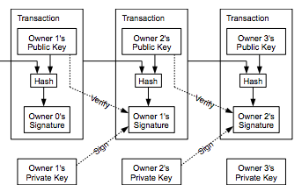
Transactions
Notes:
BLOCKCHAIN.pptx
We define an electronic coin as a chain of digital signatures. Each owner transfers the coin to the next by digitally signing a hash of the previous transaction and the public key of the next owner and adding these to the end of the coin. A payee can verify the signatures to verify the chain of ownership:

